Slide 1
OER Africa
Relevance of OER within the African ODeL higher education context

Slide 2
OER Africa PAR Grant
OUT Policy Workshop January 2016

Slide 3
Overview
Recapping OER
Why OER in Africa?
African examples

Slide 4
Recapping OER
OER Relevance

Slide 5
Quick Quiz (from TESSA)
An OER is always an online resource T/F
An OER is defined by its copyright license T/F
OER are written by academics T/F
OER are text materials T/F
OER are shareable educational resources T/F
OER can always be adapted for individual use T/F
OER should be attributed to the original author T/F
Wolfenden, Stutchbury, Erling, Amos, Enhancing Teacher education through OER. MOOC, EdX, May – July 2015

Slide 6
The OER Concept
Educational resources that are freely available for use by educators and learners, without an accompanying need to pay royalties or licence fees.
OER is not synonymous with online learning or e-learning;
Within an African context, many of the resources produced – while shareable in a digital format (both online and via offline formats such as CD-ROM) – are also printable.

Slide 7
A resource
Notes:
Almost any kind of resource has potential educational value …

Slide 8
An educational resource
What is the name of the bird in the foreground of the picture?
Can you name 3 other varieties of this kind of bird?
Notes:
… however we are most interested in resources which have been incorporated into some kind of learning activity … but can you just use it if you like it?

Slide 9
An OER
What is the name of the bird in the foreground of the picture?
Can you name 3 other varieties of this kind of bird?
This work is licensed under a Creative Commons Attribution 3.0 Unported License
Citation: Tony Mays 2011
Notes:
The “openness” relates to the way in which the resource is licensed for re-use.

Slide 10
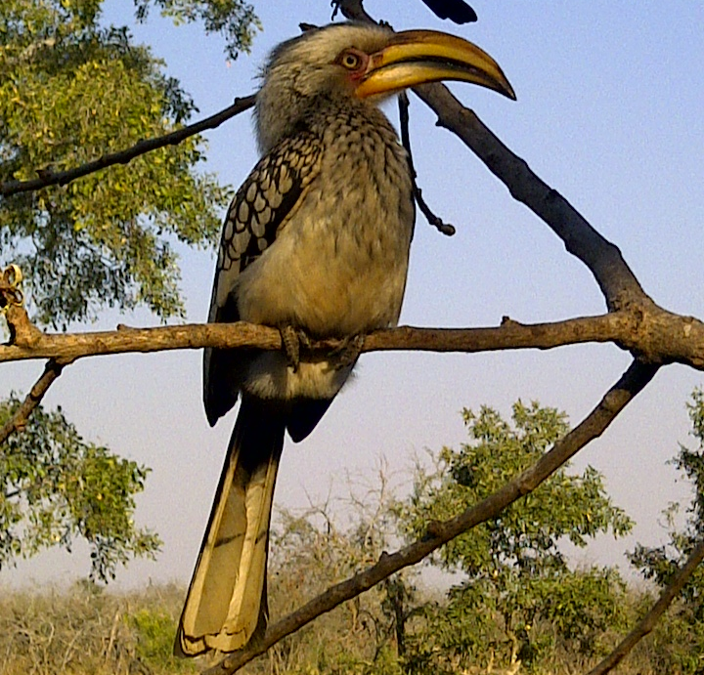
A Remixed OER
The yellow hornbill shown left is one of four varieties of hornbills common across sub-Saharan Africa. The other varieties are the grey- and red- hornbills and the much larger ground hornbill.
As the name suggests, the large horny bill is the key characteristic of the species. What does this suggest about their typical diet?
This work is licensed under a Creative Commons Attribution 3.0 Unported License
Citation: Jane Kamau 2012
Photo: Tony Mays 2011
Notes:
The least restrictive licenses allow the original resource to be adapted for a different audience or context.

Slide 11
WHY OER?
OER Relevance

Slide 12
Africa’s HE Context
Changing student profiles
Continuing students, mature students, part-time, professional…
New demands from learners
Ubiquitous access (VLEs, VLs, Open Access Journals …) etc.)
New pressures on HE systems
Delivery: face to face, distance, blended mode
Content: relevant, interactive, appropriate
New pressures on governments
Funding, connectivity, reliable power
Notes:
Image: http://wp.vcu.edu/medcgsa/wp-content/uploads/sites/2847/2013/05/graduation-cap-and-diploma.jpg

Slide 13
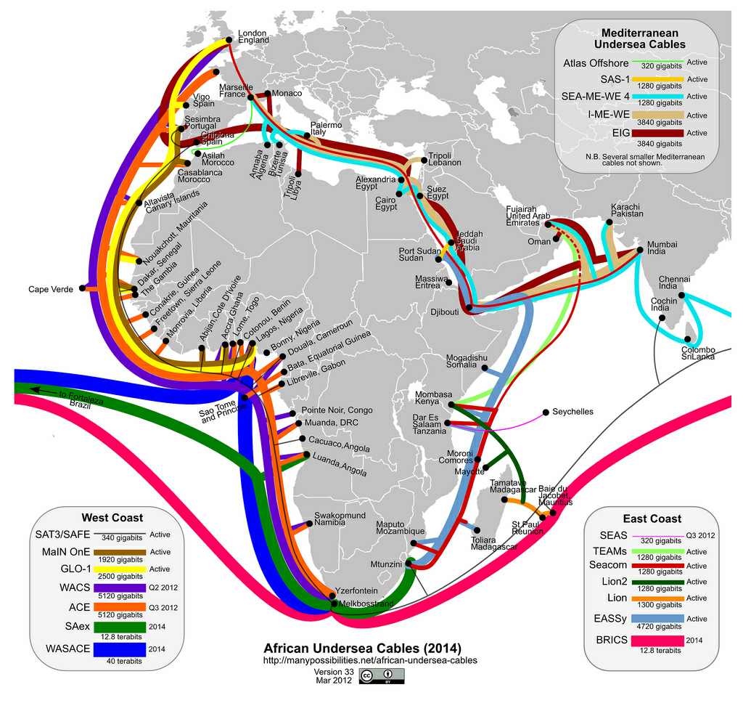
Notes:
http://jellyfishcoolman.files.wordpress.com/2009/07/african-submarine-fibre-optic-cables.jpg
Spinal Image: http://www.murrelektronik.com

Slide 14
Transformative potential
Increased availability of high quality, relevant learning materials can contribute to more productive students and educators.
The principle of allowing adaptation of materials provides one mechanism amongst many for constructing roles for students as active participants in educational processes.
OER has potential to build capacity by providing institutions and educators access, at low or no cost, to the means of production to develop their competence in producing educational materials and carrying out the necessary instructional design.
(Butcher, CoL 2011: 13)
Notes:
OER support socio-constructivist approaches and an evolving curriculum

Slide 15
A magic bullet? (from TESSA)
Net flow from north to south
0.4% of content is from Africa
Donor driven
Language – mainly in English
Uptake is slow

Slide 16
Why?
Practical
Attitudes/Cultural
Connectivity
Skills
Time
OER are a ‘quick fix’
‘We are expert’s – don’t need more resources
Using resources produced by others is ‘cheating’
Not trusting other sources
Lack of autonomy – is this resource approved by the Government/university/headteacher?
Difficulty in changing habits
Lack of collaborative mechanisms

Slide 17
Some examples
OER Relevance

Slide 18
What does OER make possible?
Notes:
Unisa CEDU required a manual, at short notice, for a workshop to train supervisors and school-based mentors to support teaching practice … so we re-purposed an existing module on Mentoring from the national ACE in School Leadership and Management …
Institutions often use OER to supplement / complement print-based materials with other media such as videos, audios, animations …

Slide 19
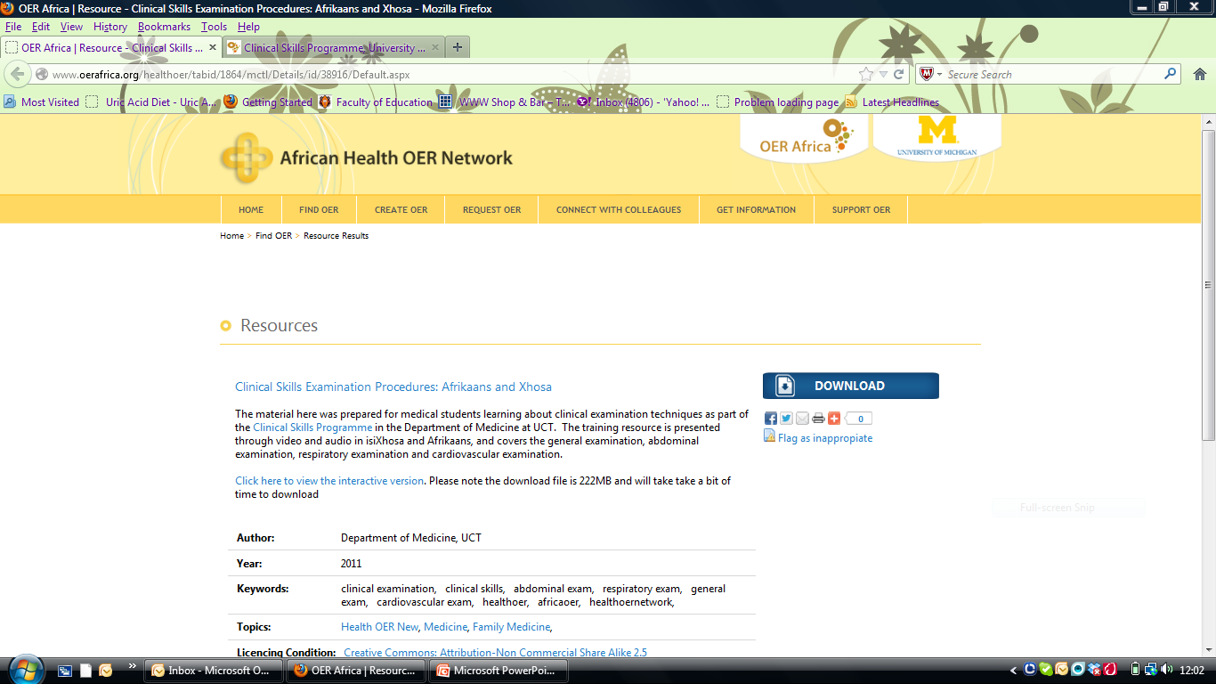
OER has the Potential
Notes:
This resource developed by UCT staff and students is now widely used across other institutions

Slide 20
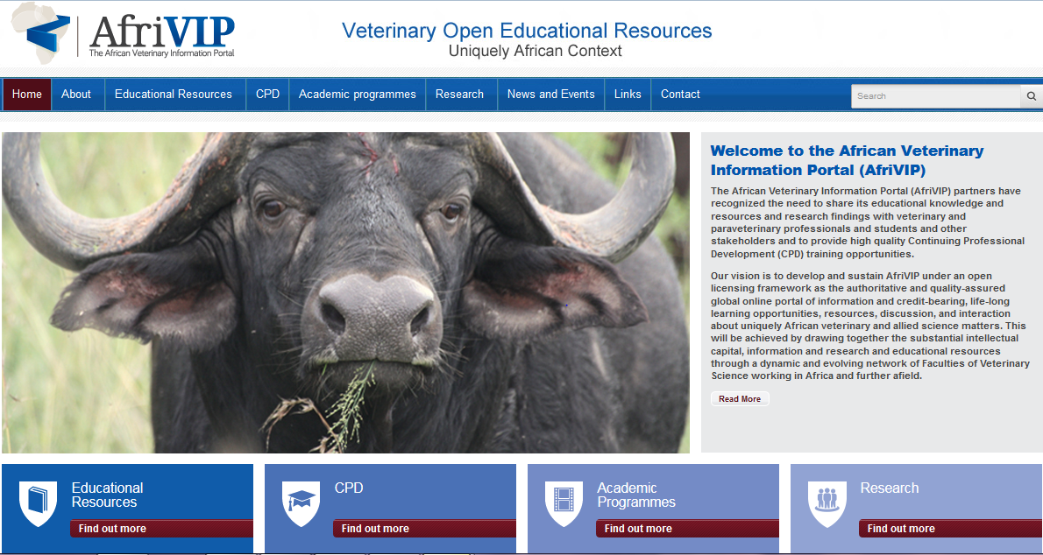
Notes:
Front page of a new OER initiative with UP: See: http://www.afrivip.org/
All the resources are Open Education Resources (OER) and therefore carry an open license (Creative Commons), allowing it to be freely copied, distributed, and adapted without asking copyright permission.
The Faculty of Veterinary Science, University of Pretoria, and its partners, has recognized the need to provide high quality Continuing Professional Development (CPD) training for veterinarians and allied professions including para-veterinary professionals. This has initiated the development of the African Veterinary Information Portal (AfriVIP), for veterinary training and information and a training platform of the OIE Collaborating Centre for Training in Integrated Livestock and Wildlife Health and Management.

Slide 21
UP Student
Student Login
Under & Post Graduate Courseware
Public Web Access to PD Materials
Database of PD materials with Open Licenses
Professional Vet
UP’s ClickUp (Blackboard LMS)
Search Facility
Content
Content
PD Test using Bb MC Tools
Option to collect PD points
On success
Payment
PD Registration
History & Payment details
1 x
CEatUP (DNN)
E-Mail confirmation to CE, SAVC and User
PD Login
Bb Blackboard Platform (LMS)
CEatUP Continuing Education Unit at UP
LMS Learner Management System
MC Multiple Choice Assessment
PD Professional Development
UP University of Pretoria
Digital Certificate (e-Mail)
Open Environment
Controlled Environment
Notes:
Open component of the platform allows for public access to the Univ. Pretoria Professional Development (PD) materials web page. No registration, nor log-in, is required and a search facility allows users to find and access Open courses and materials. This web site would be the point of entry for professionals looking for PD opportunities as well as members of the public.
The public web interface (1) accesses the open materials from a database that is also shared with the university’s ClickUp! platform.
Within the public web interface (1), on those pages of content that lend themselves to PD credits, there is a button that allows anyone to initiate a process to apply for their PD ‘credits’.
Users register the first time on the CEatUP platform and are provided with a username and password. They also fill out a limited profile that includes professional practice & payment details. On subsequent visits they simply log in using their password.
The user is then directed to the UP ClickUP platform where they complete the relevant PD multiple choice test. These short quizzes really only test comprehension and are a device to ensure the vet did read and comprehend the materials.
On successful completion of the test the user is alerted to their pass and congratulated. The points tally for that PD activity is also communicated, has the administration fee deducted from their account. PD portfolio is updated to reflect the up to date history of the user.
The Continuing Education at UP (CEatUP) unit is alerted as PD tests are completed and are responsible for managing the database of and for coordinating the e- mailing the official PD points certificate to the recipient and the the South African Veterinary Council (SAVC) although this communication process is automated.

Slide 22
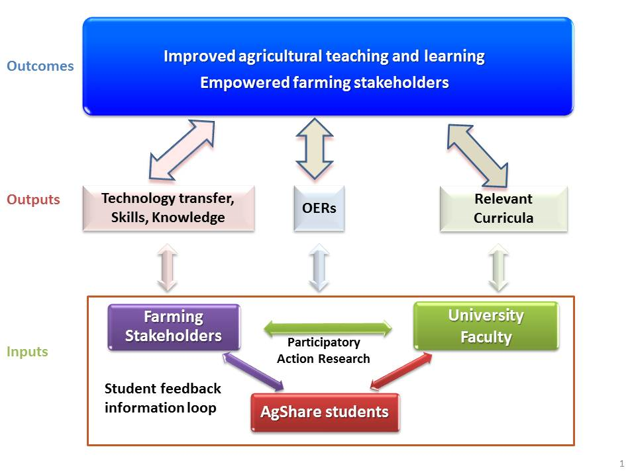
AgShare
Notes:
AgShare model

Slide 23
Other
African Story Book
Open access to M and D dissertations at most SA universities
Open spaces at Unisa, UCT, AVU, NOUN …

Slide 24
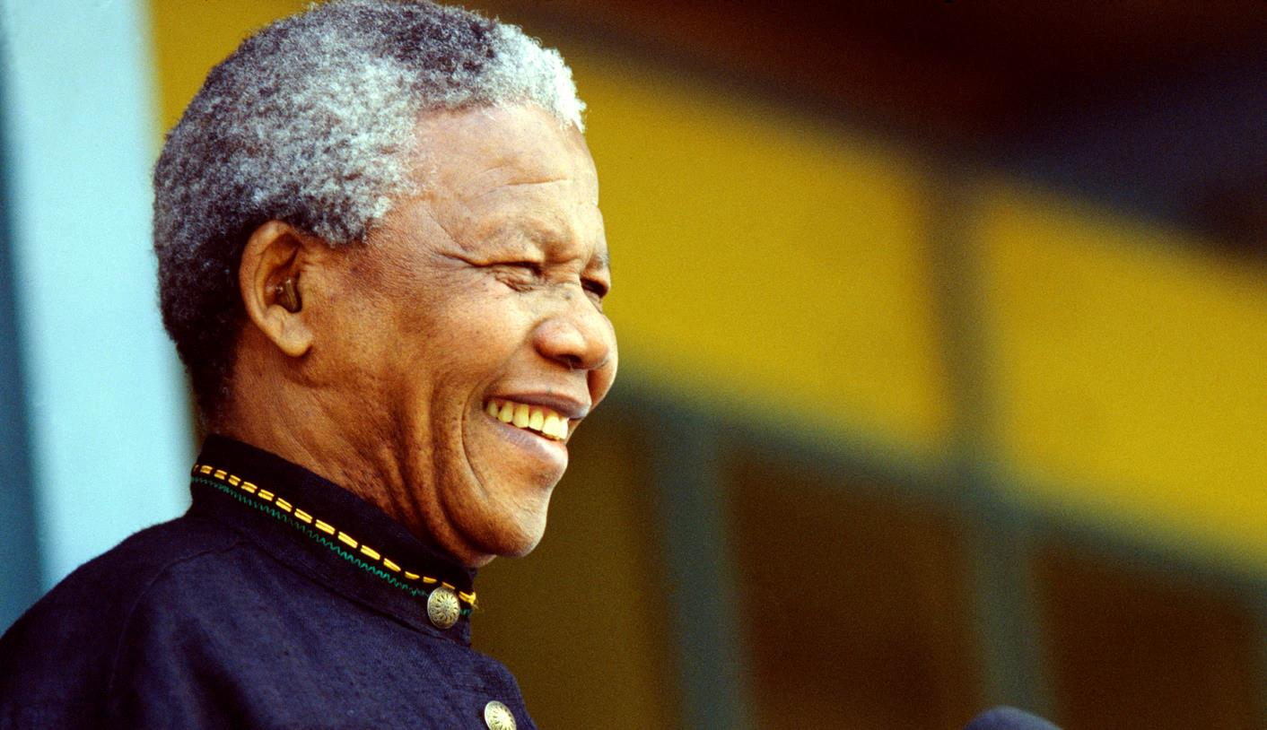
Nelson Mandela (1918 – 2013) Nobel Laureate, 1993
Education is the most powerful weapon which you can use to change the world.
Notes:
Image: http://www.dailymaverick.co.za/images/uploaded_images/article/madiba%20in%20hospital%20again.jpg
Nelson Mandela was awarded the 1993 Nobel Peace Prize for his work for the peaceful termination of the apartheid regime, and for laying the foundations for a new democratic South Africa.
See: http://www.nobelprize.org/nobel_prizes/peace/laureates/1993/mandela-wall.html

Slide 25
Thank you
This work is licensed under an
Attribution 4.0 International (CC BY 4.0) License
Tony Mays
tonym@saide.org.za

